Slide 1
“Future Stores”
Supermarket Data Mining
Guided By- Submitted By-
Prof. O. P. Vyas Neelabh Singh(ISE2011003)
Kalyan Singh Meena(ISE2011004)

Slide 2
Contents
Abstract
Problem Domain
Solution Domain
Tools & Technology used
Use Case Diagram
Activity Diagram
Description of the System
Class Diagrams

Slide 3
Abstract
Develop a software which is meant for Business Analyst of “Future Stores” Supermarket. The software will perform Association Rule Mining on given transitional data of super market sales transactions and prepares Discounting policy by preparing Combo.

Slide 4
Problem Domain
The Business Analyst wants to prepare Discounting policies by preparing various Combos.
There are some frequent data items sets which may be grouped together for a given value of support and confidence in order to prepare a Combo.

Slide 5
Solution Domain
The software will perform Association Rule Mining on given transitional data of super market sales transactions for preparing various Combos.
The software will use the Apriori Algorithm for data mining.
It will graphically represents frequent items sets for given value of minimum support and confidence.

Slide 6
Tools & Technology Used
STAR UML
Java Beans
Swing

Slide 7
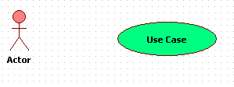
Design
Use Case Diagram :
A use case diagram in the UML is a type of behavioral diagram defined by and created from a Use-case analysis. Its purpose is to present a graphical overview of the functionality provided by a system in terms of actors, their goals (represented as use cases), and any dependencies between those use cases.
The main purpose of a use case diagram is to show what system functions are performed for which actor. Roles of the actors in the system can be depicted.

Slide 8
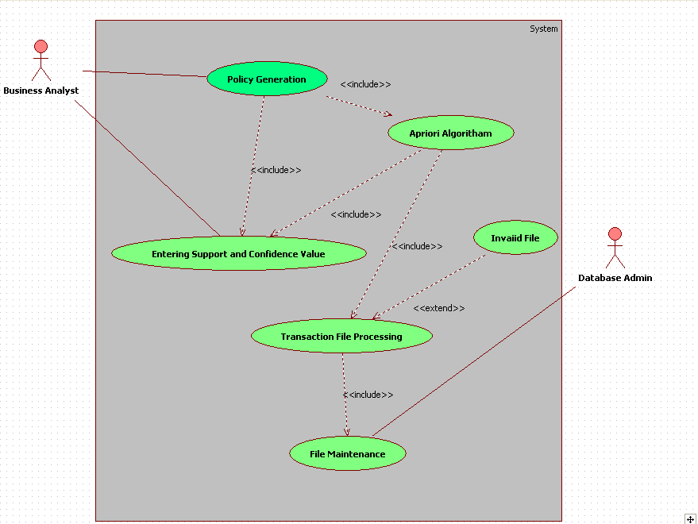

Slide 9
Activity Diagram:
Activity diagram is a graphical representations of workflows of stepwise activities .It is dynamic diagram . An activity diagram shows the overall flow of control.

Slide 10
:
The most important shapes used in activity are following
Rounded rectangles represent activities.
Diamonds represent decisions.
A black circle represents the start (initial state) .
An encircled black circle represents the end (final state).

Slide 11
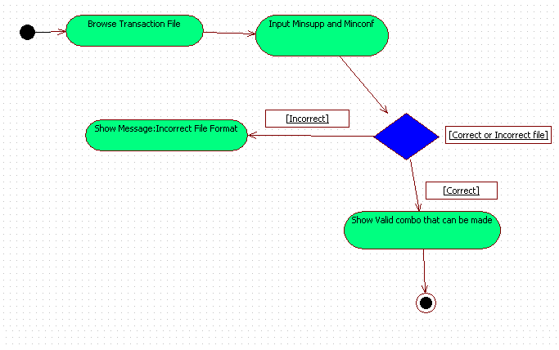
Continue…

Slide 12
Text Analysis of the whole System
Scenario 1: Mainline Sequence
1.System: Provide user interface to enter transaction file,
minimum support and minimum confidence.
2.Analyst: Enter necessary values
3.System: Find and display the association rules.
Scenario 2: At Step 2 of mainline sequence
1.System: Give the message to enter valid transaction file.

Slide 13
Continue….
Scenario 3: At Step 2 of mainline sequence
1. System: Displays the message that for minimum support or confidence values are not correct. The system displays a warning to enter valid values.
Scenario 4: At Step 3 of mainline sequence
1. System: If all entered values are correct then Displays the association rules if any else a message is shown, showing no association rule found.

Slide 14
CLASS DIAGRAM
A class diagram in the UML is a type of static structure diagram that describes the structure of a system by showing the system's classes, their attributes, operations (or methods), and the relationships among the classes. and So the purpose of the class diagram can be summarized as:
Analysis and design of the static view of an application.
Describe responsibilities of a system.

Slide 15
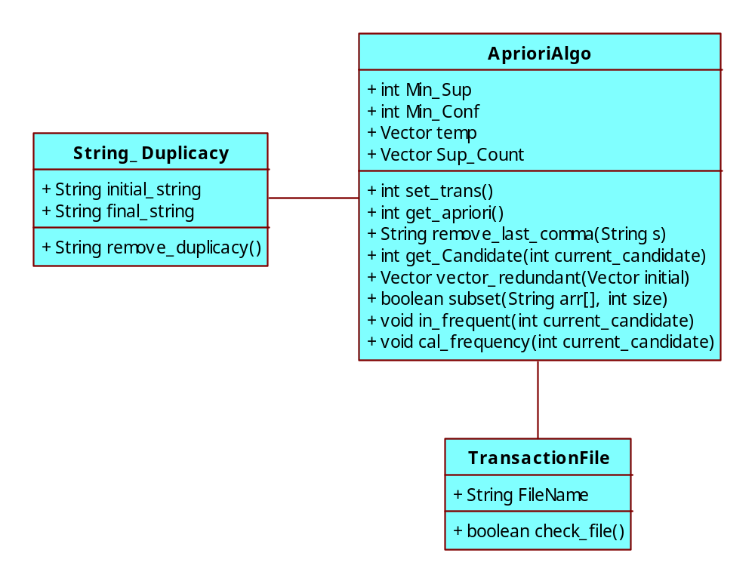

Slide 16
Example of a transaction file
TID List of Items
T100,I1, I2, I5,
T101,I2, I4, ,
T102,I2, I3, ,
T103,I1, I2, I4,
T104,I1, I3, ,

Slide 17
Implementation
Association Rule Mining :
Finding frequent patterns, associations, correlations, or causal structures among sets of items or objects in transaction databases, relational databases, and other information repositories.
For e.g., the customers who purchase bread also tend to buy butter-
bread=>butter

Slide 18
Continue……
Association rule mining is a two-step process:
  Find all frequent item sets.
  Generate strong association rules from the frequent item sets.
These are calculated on the basis of two parameters – support , confidence.
Support(A=>B)=#_tuples_containing_bothA_and B/(total _#_of_tuples)
Confidence(A=>B)=#_tuples_containing_bothA_and B/(#_of_tuples
_contain A)

Slide 19
References
http://en.wikipedia.or
J. Han, M. Kamber (2001), Data Mining, Morgan
Kaufmann Publishers, San Francisco, CA
Complete Reference in Java.

Slide 20
Thank You…

